Slide 1

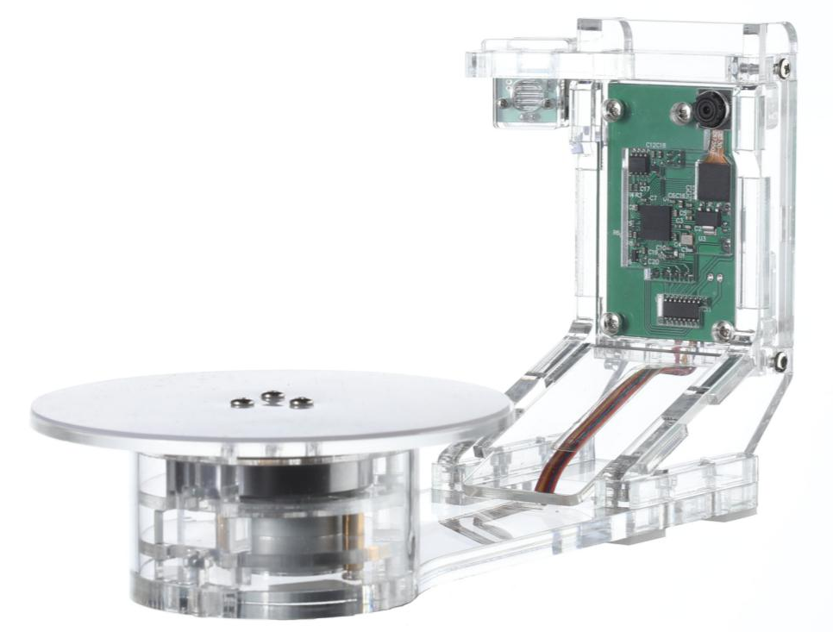
YScanner-Mini
Scaner Size | 23×15×16 cm
Scan Resolution | 0.2mm
Camera Resoution | 130 Megapixel
Interface | USB2.0，USB3.0
Operating System | win7 win8 win10
Power Supply | USB ，No Extra Power
Scanning Rage | 10×10×10 cm
3D Data Format | ply
Light Source | Red Laser
Rotation Bearing | <0.6kg
Color Scan | 6min 40s
Mesh Scan | 3min 20s
Designed for small object 3D Scanning(Size less than 10×10×10 cm)

Slide 2
YScanner-Standard
Scaner Size | 44×19×16 cm
Scan Resolution | 0.3mm
Camera Resoution | 130 Megapixel
Interface | USB2.0，USB3.0
Operating System | win7 win8 win10
Power | USB ，No Extra Power
Scanning Rage | 20×20×20 cm
3D Data Format | ply
Light Source | Red Laser
Rotation Bearing | <2.0kg
Color Scan | 6min 40s
Mesh Scan | 3min 20s
Designed for standard object 3D Scanning(Size less than 20×20×20 cm)

Slide 3
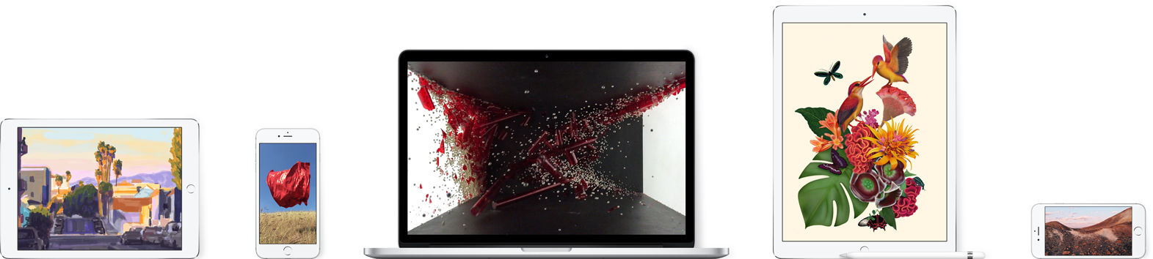
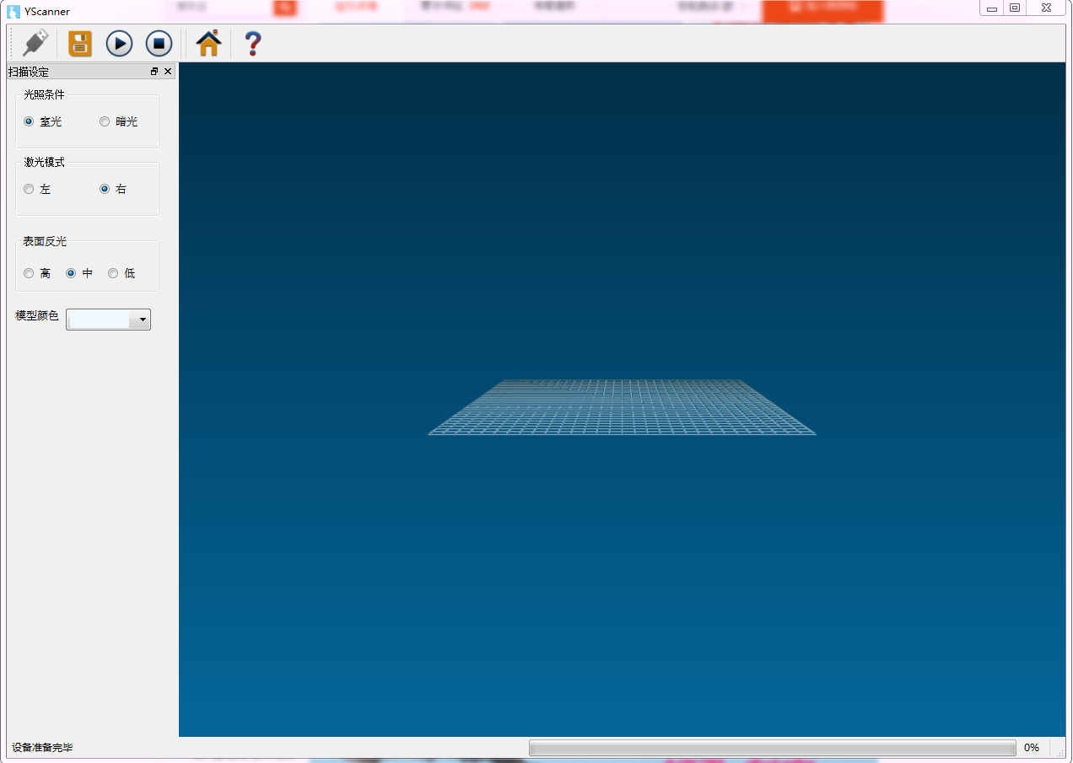
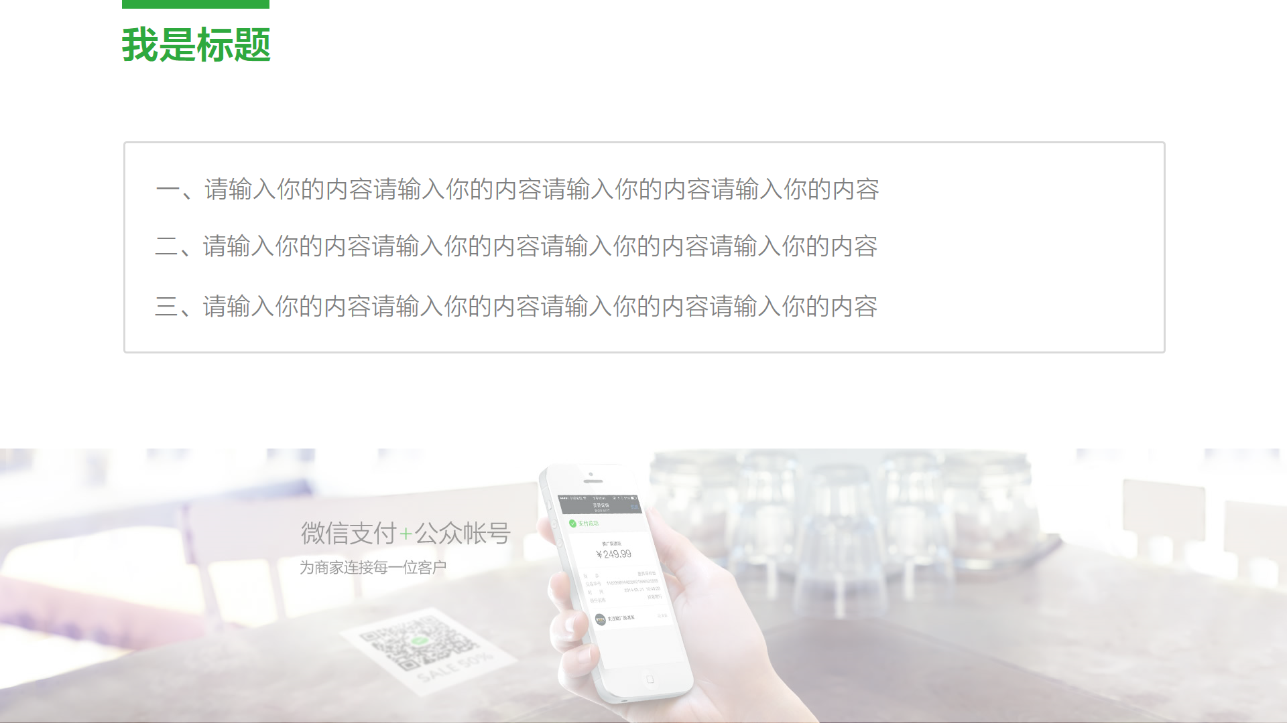

YScanner-Software
Designed to be EASY to use,without complex settings
Plug and Play without extra installsettings

Slide 4
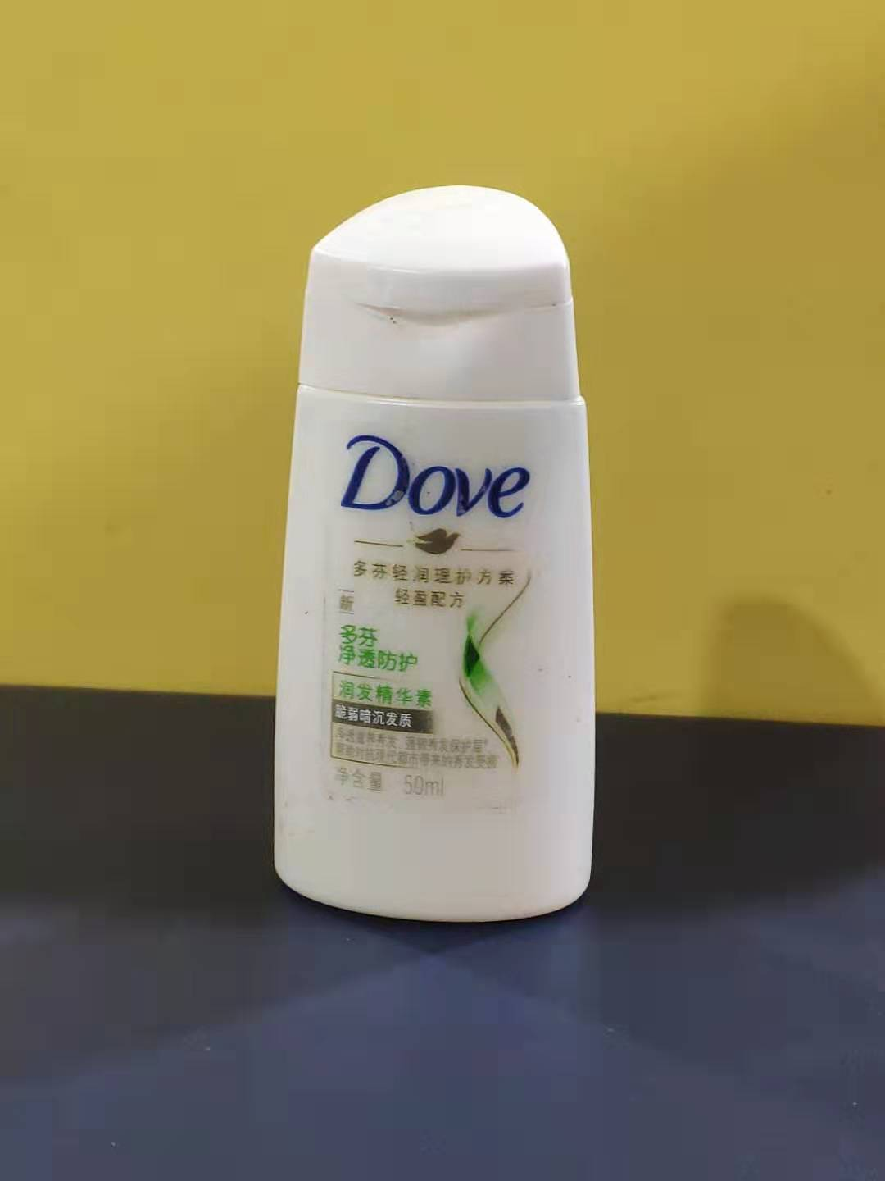
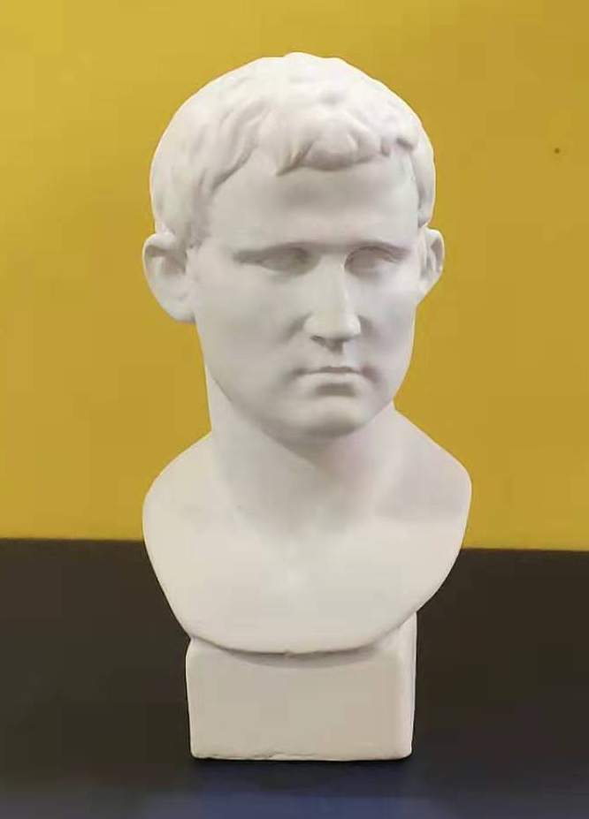
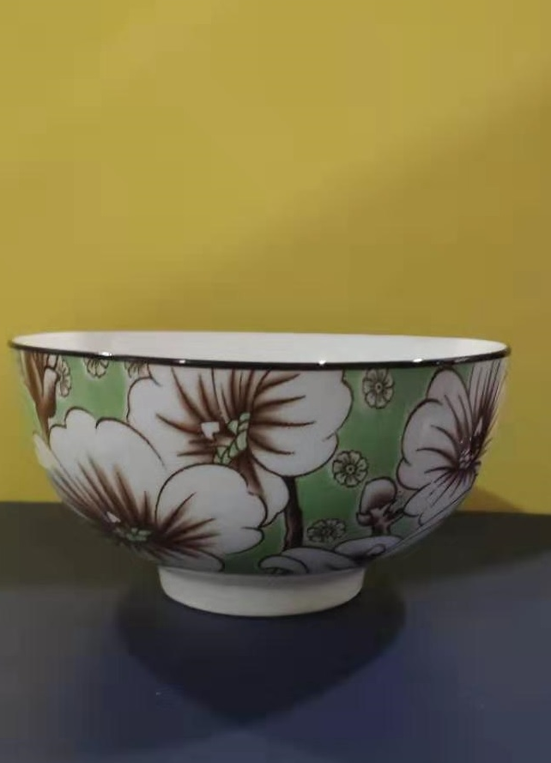
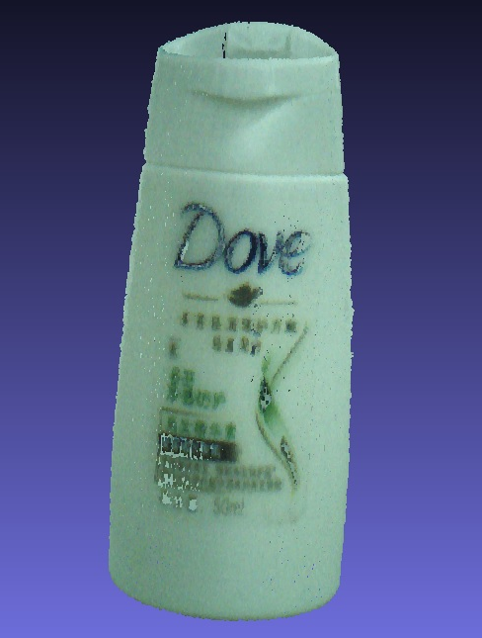
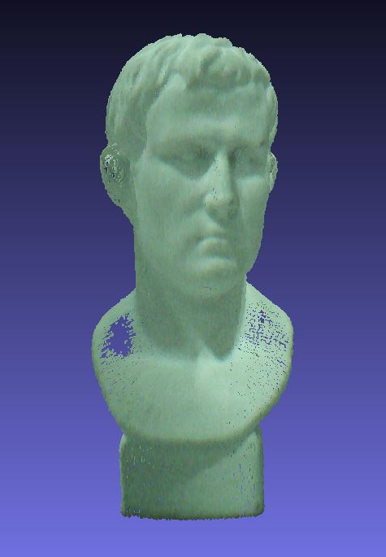
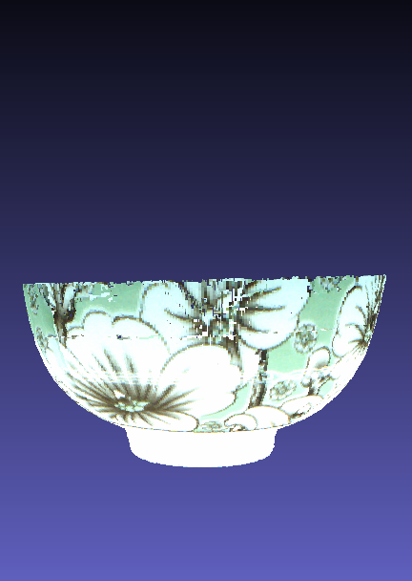
3D Scanning Result
Pbjects for scanning
Dove
Status
Bowl
Scanned 3D Data
Dove
Status
bowl

